Slide 1
Employee Performance Analysis Using Excel
PRESENTED BY: Sabura Banu M
REGISTER NO: 2213331042137
DEPARTMENT: COMMERCE
COLLEGE:Bharathi women's college

Slide 2
PROJECT TITLE
Employee Performance Analysis Using Excel

Slide 3
AGENDA
1.Problem Statement
2. Project Overview
3.End Users
4.Our Solution and Proposition
5. Dataset Description
6. Modelling Approach
7. Results and Discussion
8.Conclusion

Slide 4
PROBLEM STATEMENT
1.Ensuring Accurate Data Representation: The problem statement outlines the need to accurately categorize employee performance scores into the appropriate evaluation criteria: Exceeds, Fully Meets, and Needs Improvement. This is crucial for ensuring that the pivot table correctly represents employee performance and that decisions based on this data are well-informed
2. Validating Data Integrity: By clearly defining the problem, you set the foundation for verifying that the total scores in each category correctly sum up to the overall Grand Total. This helps in identifying any discrepancies or errors in data entry, which is essential for maintaining the reliability of the analysis.
3. Facilitating Effective Analysis: The problem statement provides a framework for analyzing the performance distribution across different categories. It ensures that the data can be analyzed effectively to uncover trends and insights, which are critical for performance management and organizational decision-making.

Slide 5
PROJECT OVERVIEW
Accurate Data Categorization
Validation of Totals
Performance Insights
Clarity of Analysis
Enhanced Reporting

Slide 6
WHO ARE THE END USERS?
Human Resources (HR) Department
Senior Leadership/Executives
Employees
Department Managers (Sales &amp;amp;amp;amp; Production)
Finance/Compensation Teams

Slide 7
OUR SOLUTION AND ITS VALUE PROPOSITION
Filtering- Remove missing values.
Conditional Formatting- Blanks, Background Colour Shading, Data Bars , Values.
Data Filtering and Sorting- Identify specific employee groups, such as those with Exceed, Fully meet, Need Improvement.
Pivot table- Summary of employee performance under their current rating.
Graphs- Final Report.

Slide 8
DATASET DESCRIPTION
EMPLOYEE ID: Unique identifier for each employee in the organization.
FIRST NAME: The first name of the employee.
Performance Score: A score indicating employee’s performance level (e.g., Excellent, Satisfactory, Needs Improvement).

Slide 9
MODELLING
Data set: Kaggle, Employee dataset.
Feature Selection: Slicer, Conditional Formatting, Designing.
Data Cleaning: Missing values, Irrelevant data, correct errors, Remove Unnecessary columns and Rows.
Pivot Table: Employee ID, First Name, Performance Score.
Chart: Report of Employee Performance based on their employee ID is represent in Values and performance score presented as column chart.

Slide 10
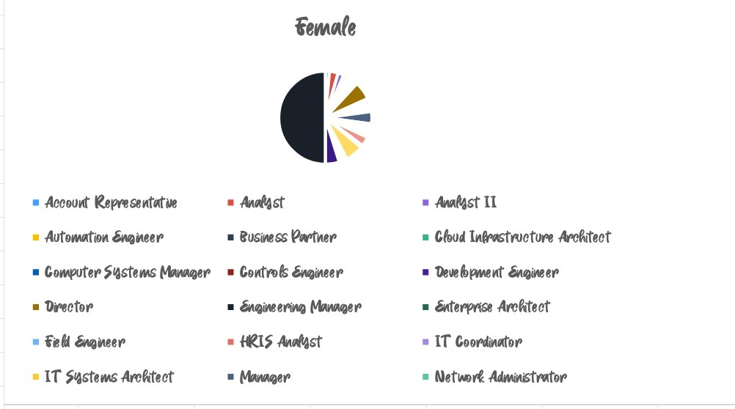
RESULTS

Slide 11
CONCLUSION
Data Accuracy and Consistency: The conclusion confirms that the pivot table accurately categorizes employee performance scores and that the totals for each category correctly sum up to the overall Grand Total. This accuracy ensures that the analysis is reliable and that stakeholders can trust the reported figures.
2. Performance Distribution Insight: The pivot table provides a clear view of how performance scores are distributed across the three evaluation categories. This insight is crucial for understanding overall employee performance and identifying patterns, such as a predominance of scores in the "Fully Meets" category.
Conclusion: The pivot table's conclusion underscores its importance in accurately categorizing and summarizing employee performance data. It ensures data integrity, provides valuable insights into performance distribution, supports informed decision-making, and aids in effective reporting and strategic planning.

Slide 12
REFERENCE
Mrs HAMSA VENI
Assistant Professor
Bharathi women's college
Chennai, Tamil Nadu

